Slide 1
PREDICTING ROAD ACCIDENT SEVERITY
By: New Ru Wee

Slide 2
INTRODUCTION
Road accidents is a major problem in the modern world – it is said more people are killed by road accidents than plane crashes. The objective of this analysis to investigate which are the factors driving the severity of a collisions and provide insights to the community on possible to reduce road accidents.
The dataset is taken from SDOT Traffic Management Division, Traffic Records Group from 2004 to 2020. The dataset has 38 columns consisting of 194673 observations without any duplicates. This dataset is a hybrid combination of numerical and categorical data types.

Slide 3
PROBLEM
The first problem would be to identify which are the features which are driving the road accidents severity. Each column in the dataset represent a feature. In process of doing so, the features of importance are also being identified.

Slide 4
INTEREST
This analysis will be of interest to the authorities, insurance company and community when trying to reduce severe road accidents. Road accidents not only cause loss of lives but also cause injuries and monetary loss to individual, insurance companies and community.

Slide 5
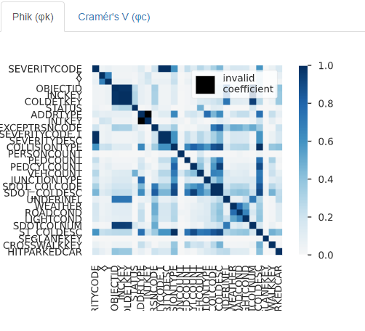
Heatmap of correlation between features

Slide 6
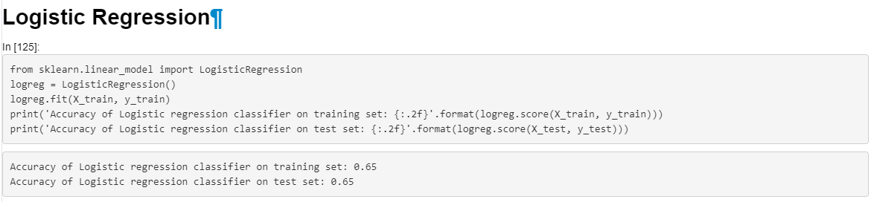
Logistic Regression

Slide 7
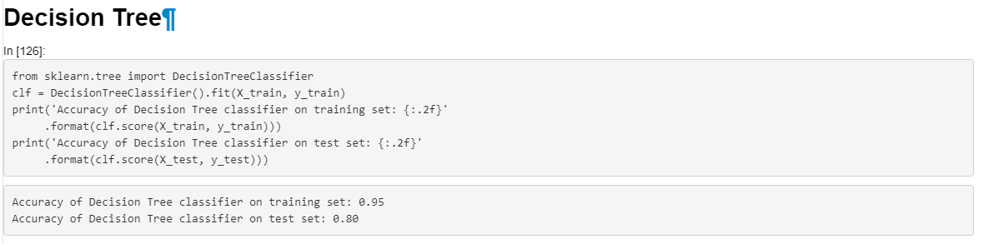
Decision Tree

Slide 8
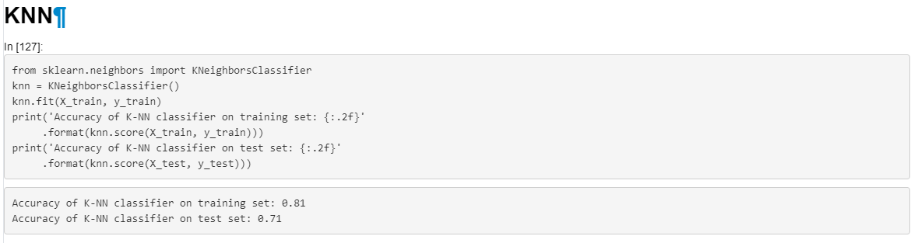
KNN

Slide 9
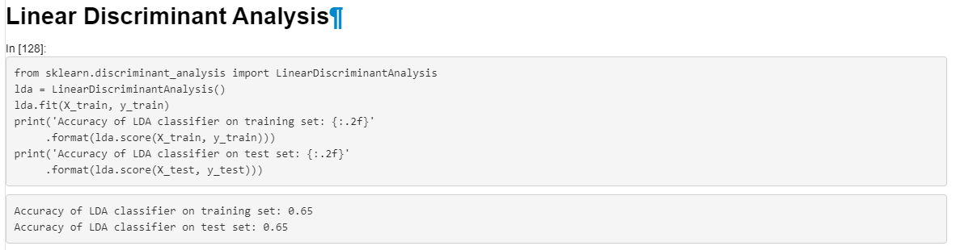
LDA

Slide 10
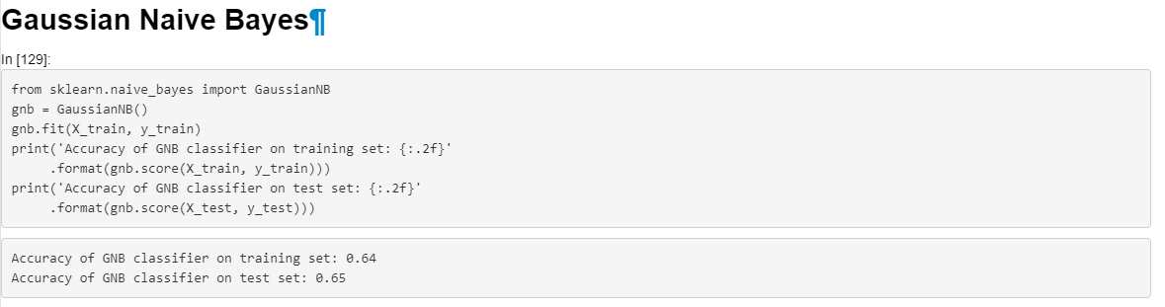
Gaussian Naïve Bayes

Slide 11
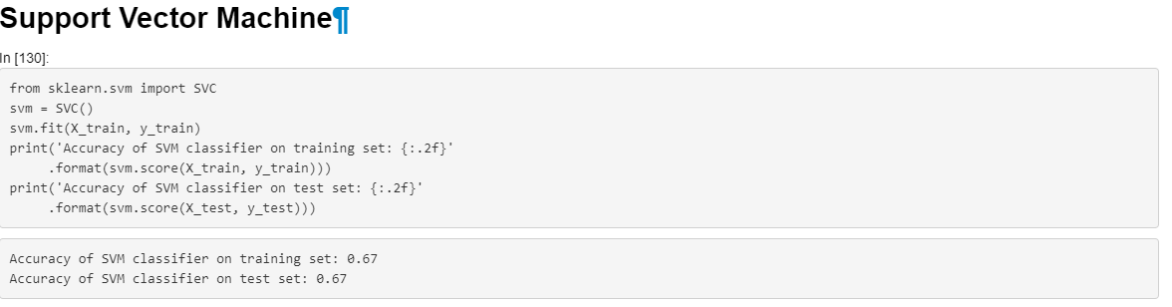
SVM

Slide 12
CONCLUSION
From the accuracy obtained, it seems like Decision Tree is the best model for this dataset.

